Slide 1
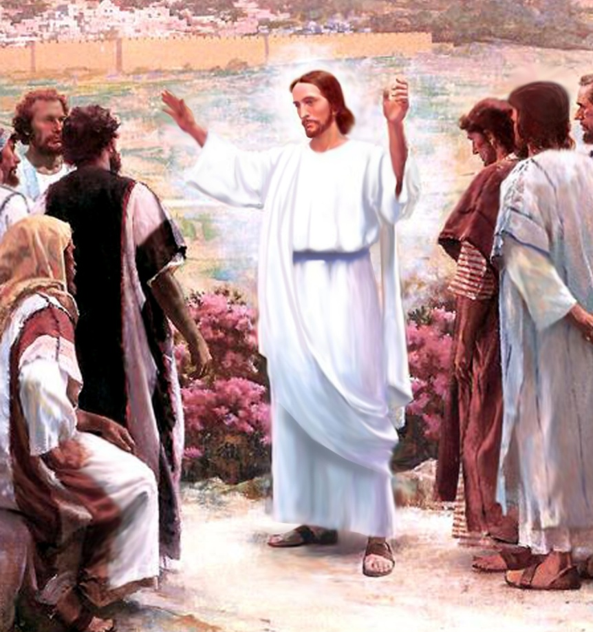
CATECHETICAL TEXTBOOK SERIES OF THE SYRO - MALABAR CHURCH
ON THE PATH OF SALVATION - 10
10
CHURCH
THE MISSIONARY COMMUNITY

Slide 2

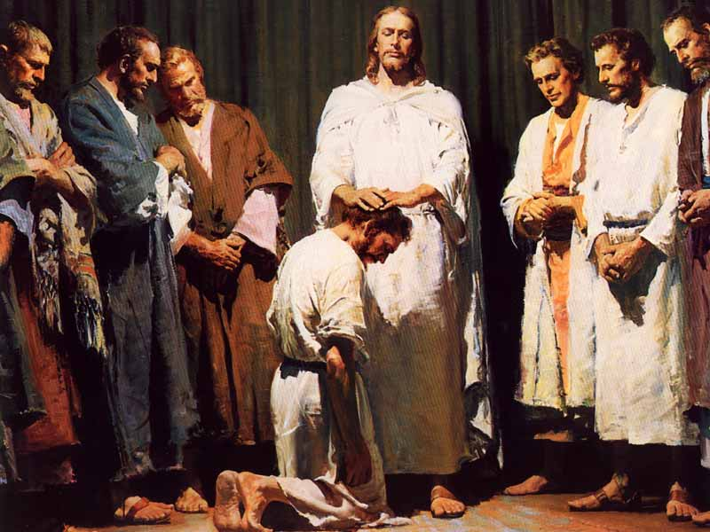
LESSON 1
CHURCH: MISSIONARY BY NATURE

Slide 3
JESUS TOLD THEM “GO THEREFORE AND MAKE DISCIPLES OF ALL NATIONS, BAPTIZING THEM IN THE NAME OF THE FATHER AND OF THE SON AND OF THE HOLY SPIRIT, AND TEACHING THEM TO OBEY EVERYTHING THAT I HAVE COMMANDED YOU (MT. 28: 19-20).

Slide 4
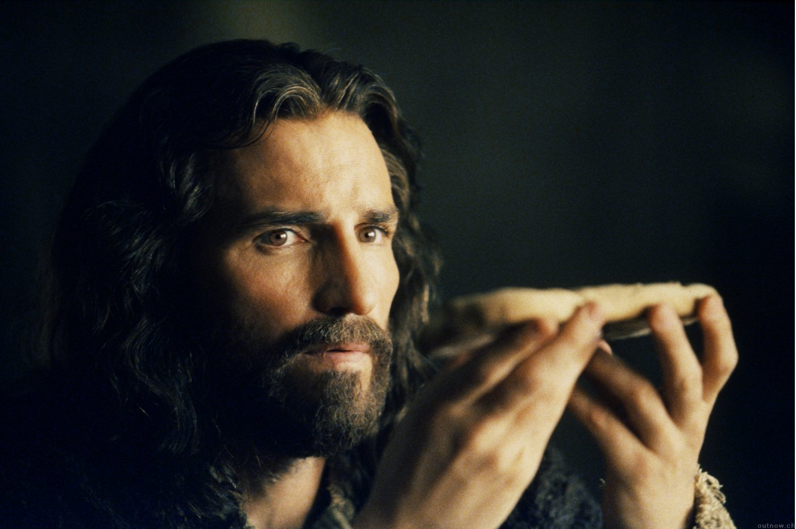
THE COMMANDMENT OF THE LORD
“DO THIS IN REMEMBRANCE OF ME” “GO INTO ALL THE WORLD AND PROCLAIM THE GOOD NEWS TO THE WHOLE CREATION” PROCLAMATION OF THE GOSPEL, IS THE MISSION WHICH JESUS ENTRUSTED TO THE CHURCH THROUGH THE APOSTLES.

Slide 5
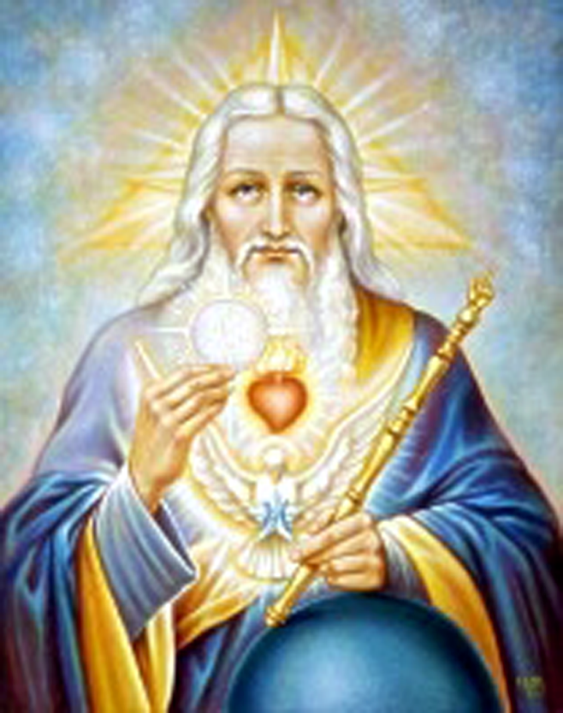
THE FATHER SENDS HIS SON
GOD THE FATHER SENT HIS SON INTO THE WORLD ‘TO RESCUE US FROM THE POWER OF DARKNESS’ (COL. 1:13) AND ‘TO MAKE ALL MANKIND HIS FRIENDS THROUGH CHRIST’ (2 COR 5:19). THE MISSIONARY TASK OF THE SON WAS TO DO THE WILL OF HIS FATHER (JN 5:30).

Slide 6
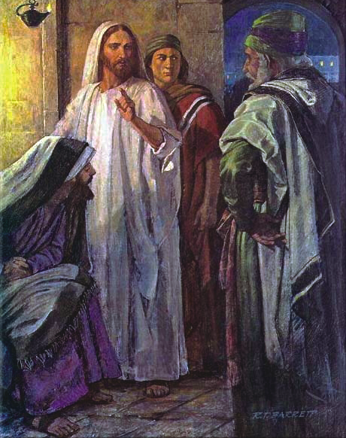
JESUS: THE FIRST MISSIONARY
JESUS IS THE GOSPEL OF GOD THE FATHER THE BEGINNING OF ALL MISSIONARY ACTIVITY IS THE SENDING OF JESUS TO THE WORLD. JESUS IS THE PRIMARY SPOKESMAN OF THE GOSPEL.

Slide 7
THE ORIGIN OF THE WORDS ‘MISSION’ AND ‘MISSIONARY’, COMES FROM THE LATIN WORD ‘MITERE’ WHICH MEANS ‘TO SEND’. THE WORD ‘MISSION’ REFERS TO THE TASK OF THE ONE WHO IS SENT. ‘MISSIONARY’ MEANS ‘THE ONE WHO IS SENT’.
THE MESSAGE OF JESUS WAS ABOUT THE KINGDOM OF GOD AND SALVATION OF MAN.

Slide 8

MISSIONARY ACTION OF THE HOLY SPIRIT
GOD SENT THE HOLY SPIRIT TO HELP MAN TO OWN THE SALVATION WHICH JESUS GAINED FOR US. THE ORIGIN OF THE CHURCH ARISES FROM THE MISSION OF THE SON AND THE HOLY SPIRIT ACCORDING TO THE PLAN OF GOD THE FATHER.

Slide 9
CHURCH: SENT BY CHRIST
THE CHURCH IS THE CONTINUATION OF CHRIST. AND THE CHURCH HAS TO CONTINUE THE MISSION OF JESUS. SHE IS CALLED AND SENT FOR THAT. JESUS SAID TO HIS DISCIPLES: “AS THE FATHER HAS SENT ME, SO I SEND YOU”
THE CHURCH WHO RECEIVED THIS MISSION FROM JESUS CO-OPERATES WITH HIM IN THIS SALVIFIC PLAN AND LEADS PEOPLE TO SALVATION. HENCE THE CHURCH IS THE SACRAMENT OF UNIVERSAL SALVATION.

Slide 10
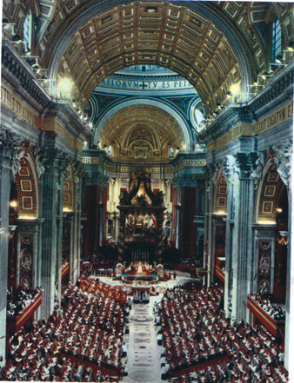
MISSIONARY CHURCH
THE MISSIONARY TASK ENTRUSTED TO THE CHURCH BY JESUS THROUGH THE APOSTLES IS TO PROCLAIM THE GOSPEL TO ALL PEOPLES, BAPTISE THEM, TEACH THEM TO OBEY WHATEVER HE HAS COMMANDED AND BE WITNESSES TO HIS LOVE (MT. 28: 18-20). BY THE TERM ‘MISSION’ WE MEAN PROCLAIMING THE GOSPEL TO PEOPLES AND COMMUNITIES WHO HAVE NOT YET HEARD OF CHRIST AND INSTITUTING THE CHURCH THERE. MISSIONARY ACTIVITY IS PROCLAIMING THE SALVIFIC PLAN OF GOD AND ITS FULFILMENT IN THE WORLD AND IN HISTORY. (REDEMPTORIS MISSIO-RM-41).

Slide 11
ALL ARE MISSIONARIES
SINCE THE CHURCH IS MISSIONARY BY NATURE, ALL THE PEOPLE OF GOD ARE MISSIONARIES. THE DUTY OF PROCLAIMING THE GOSPEL TO OTHERS IS DONE BY THE SONS AND DAUGHTERS OF THE CHURCH.

Slide 12
LET US
READ THE WORD OF GOD AND MEDITATE
JN. 20: 19-23

Slide 13
A WORD OF GOD TO REMEMBER
“AS THE FATHER HAS SENT ME, SO I SEND YOU” (JN. 20:21).

Slide 14
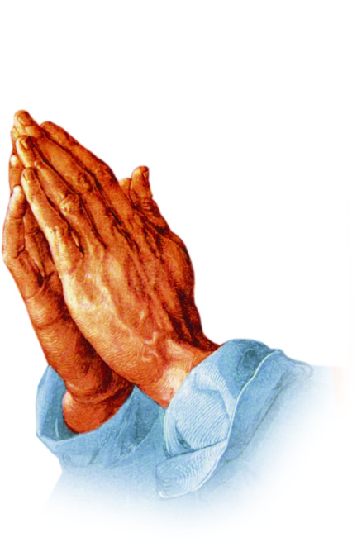
LET US PRAY
JESUS, OUR LORD, BLESS US TO LIVE ACCORDING TO
OUR MISSIONARY CALL AND TASK AND BE YOUR WITNESSES.

Slide 15
MY DECISION
I WILL THANK MY GOD DAILY FOR GIVING ME PARTICIPATION
IN THE MISSIONARY TASK OF THE CHURCH THROUGH BAPTISM AND ANOINTING.

Slide 16
LET US THINK WITH THE CHURCH
ONCE JESUS PREACHED AND FULFILLED THE GOSPEL FOR THE SALVATION OF WHOLE HUMANITY. IT IS NECESSARY TO PREACH AND SPREAD THIS GOSPEL FROM JERUSALEM TO THE ENDS OF THE EARTH. THUS, THE SALVATION WHICH JESUS ONCE GAINED FOR ALL SHOULD BECOME EFFECTIVE IN ALL IN THE PROCESS OF TIME. (AG. 3)

Slide 17
WHAT CHILDREN SHOULD UNDERSTAND:
CONVICTION
- JESUS WHO HAS BEEN SENT BY THE FATHER IS THE FIRST MISSIONARY
- THE CHURCH HAS BEEN SENT BY JESUS CHRIST.
- THE MOST IMPORTANT MISSION OF THE CHURCH IS PREACHING THE WORD OF GOD.
- IT IS THE HOLY SPIRIT WHO PREPARES US TO RECEIVE THE GOOD NEWS.

Slide 18
- SINCE THE CHURCH HAS RECEIVED THE MISSIONARY TASK FROM JESUS AND CO- PERATES WITH HIS PLAN OF SALVATION, THE CHURCH COULD BE CONSIDERED AS THE SACRAMENT OF UNIVERSAL SALVATION.
- PREACH THE GOSPEL TO ALL THE PEOPLES; BAPTISE THEM; TEACH THEM TO FOLLOW WHAT HE HAS COMMANDED AND WITNESS HIS LOVE: THESE WERE THE MISSIONS THAT JESUS GAVE TO THE CHURCH THROUGH HIS DISCIPLES.
- SINCE THE CHURCH IS MISSIONARY BY NATURE, ALL ITS MEMBERS ARE ALSO MISSIONARIES.

Slide 19
WHAT CHILDREN SHOULD UNDERSTAND:
ATTITUDE
- CONVICTION ABOUT ONE’S MISSIONARY RESPONSIBILITY.
- WILL TO SHARE THE WORD OF GOD WITH OTHERS.

Slide 20
WHAT CHILDREN SHOULD UNDERSTAND:
HABIT
- WILL SPEAK ABOUT JESUS TO OTHERS.
- WILL PRAY FOR THE SUCCESS OF MISSIONARY ACTIVITIES.

Slide 21



Thank you

